Slide 1

Music recommendation system based on facial emotion gestures
Batch number - 207

Slide 2
Batch – 207 Details
P. Akash Babu (171FA04231)
K. V. N.S. Chakradhar (171FA04279)
P. Yasaswi (171FA04229)
Working under the Esteemed Guidance of
Mr. S. V. Rama Krishna, Asst. Professor,
Dept. of CSE,
VFSTR

Slide 3
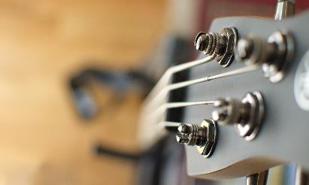
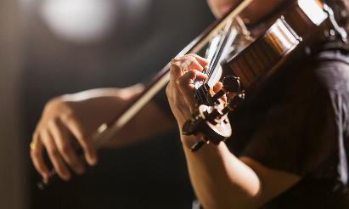
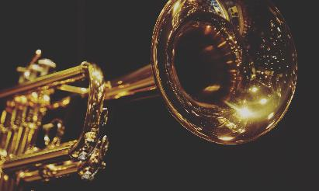
CONTENTS
Project Abstract
Detailed explanation of project
Functional, nonfunctional, software and hardware requirements
Technologies to be used
Design of project

Slide 4



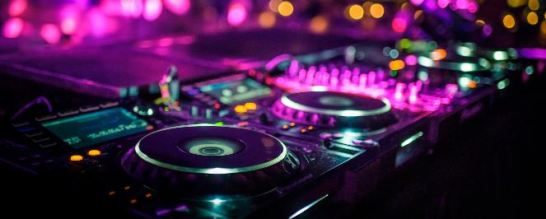
abstract
Music plays a vital role in our every day life. Life without music cannot be imagined. Music changes our mood, We listen to music when we are Happy. We also listen to music when we are Sad. We listen to music when we are bored. Music can induce a clear emotional response in its listeners. The pitch and rhythm of the music are managed in the areas of the brain that deal with emotions and mood. Thus, music plays an important role in enhancing our mood. As elders have said “Face is the Index of the Mind”, the mood of a person can be known by looking at the face of the person. The abstract of this system/ project is to build an automated system that builds playlists and plays the songs according to the mood of the user by directly discerning the facial emotions of the user. This model requires a camera to capture the face of the user and then the mood of the user is recognized by CNNs. Then the playlist is recommended to the user based on the discerned “Mood” of the user. This eliminates the time-consuming and tedious task of manually segregating or grouping songs into different lists and helps in generating an appropriate playlist based on an individual's emotional features. Hence, the proposed system can be used to build a music recommendation system based on the facial emotion gestures of the user.

Slide 5
motivation
Music deftly plays with our emotions which in turn affect our mood. Music induces a clear emotional response in its listeners.
Though, there are music recommendation systems based on happy and sad moods of the user still there are no effective algorithms and models which recognizes emotions like surprise , anger also effectively.
Manual classification of songs based on mood, for making of a playlist, is time consuming and labor intensive. So, we thought of providing automatic music recommendation system based on human emotions.
This system is a cost-efficient, easy to implement and one of the most effective systems for recommendation of music based on the emotions of the user.

Slide 6

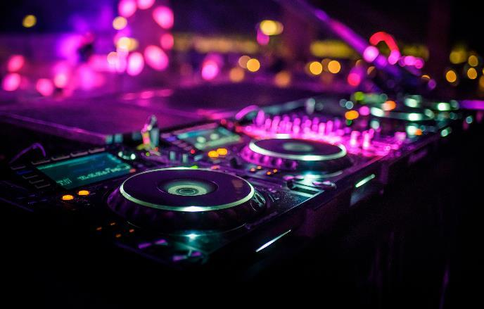
introduction

Slide 7
introduction
Music induces a clear emotional response in its listeners. Musical preferences have been demonstrated to be highly correlated with personality traits and moods.
Facial expressions are the most ancient and natural way of conveying emotions, moods and feelings.
As a deep learning neural network, convolutional neural network plays an extremely important role in face image recognition.
Cognition technology of convolutional neural network and automatic music recommendation system is developed to identify a model that recognizes facial expressions and recommends music according to corresponding mood of the user.

Slide 8
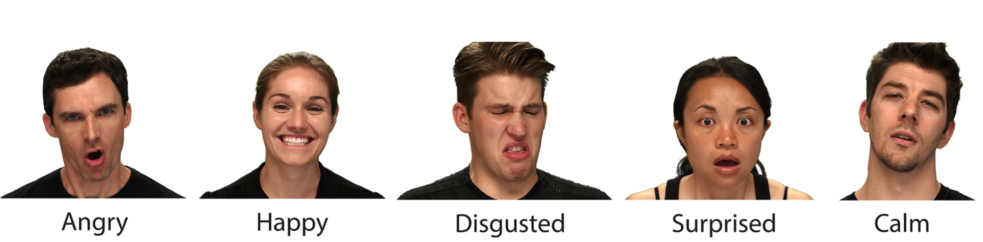
introduction
Fig 1:Facial expression with different emotions

Slide 9
DEEPFACE LIBRARY
DeepFace is a Deep Learning Facial recognition system created by the Facebook research group. It identifies human faces in digital images. The program has a 9 layer neural network with over 120 million connection weights and was trained on four million images that were uploaded by the Facebook users. The Facebook Research team has stated that the DeepFace method reaches an accuracy of 97.35%. In such case, the DeepFace library is sometimes more accurate that the human beings.

Slide 10

Functional & Non-functional requirements

Slide 11
Functional & Non-functional requirements
Software Requirements
Python3
Python libraries like –
CV2
NumPy
Matplotlib
TensorFlow
Keras
DeepFace

Slide 12
Functional & Non-functional requirements
Hardware Requirements
Modern Operating System (Window 7 or 10)
x86 64-bit CPU
4GB RAM
5GB Free disk Space

Slide 13

Design of the Project

Slide 14
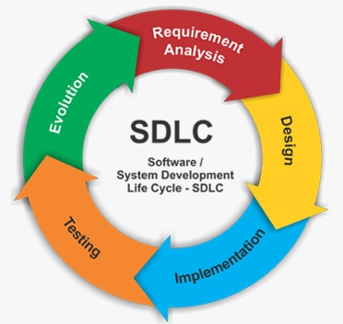
Software development life cycle
Step 1 Data Collection from Repositories
Step 4 Training
Step 5 Classifier
Step 6 Music Recommendation
Step 2 Pre-Processing
Step 3 Model Construction

Slide 15
Software development life cycle
Data Collection
DeepFace
Emotion Recognition
Music Recommendation

Slide 16
IMPLEMENTATION OF THE PROJECT

Slide 17
Proposed system
The Proposed system contains three modules namely Data Augmentation, Model Training& Testing, Face Detection & Emotion Recognition and Music Recommendation. The first two modules are done in the DeepFace library itself.

Slide 18
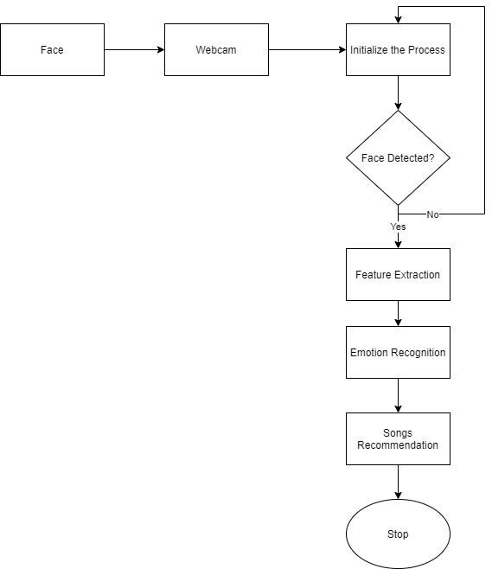
Process FLOW DIAGRAM
DeepFace Library

Slide 19
Working of deepface
The DeepFace device deals with a face check calculation, organized by man-made brainpower (AI) strategies utilizing neural organization models. A neural network is an assortment of prepared neurons that perform different actions and gives possible outcomes based on the emotion of a human being
As Facebook uses a high-level rendition of this methodology, the means are a smidgen more developed and explained than these. Adding the 3D change and piece-wise relative change in the system, the calculation is engaged for conveying more precise outcomes.

Slide 20
alignment
The goal of this alignment part is to generate frontal face from the input image that may contain faces from different pose and angles. The method proposed in this paper used 3D frontalization of faces based on the fiducial (face feature points) to extract the frontal face. The whole alignment process is done in the following steps.
2D Alignment
3D Alignment
Frontalization

Slide 21
2D alignment
The DeepFace process begins by detecting 6 fiducial points on the detected face — the center of the eyes, tip of the nose and mouth location. These points are translated onto a warped image to help detect the face. However, 2D transformation fails to compensate for rotations that are out of place.

Slide 22
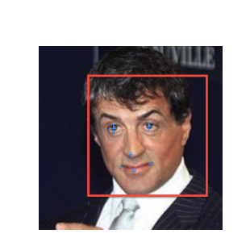
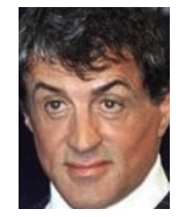
2d alignment

Slide 23
3d alignment
In order to align faces, DeepFace uses a generic 3D model wherein 2D images are cropped as 3D versions. The 3D image has 67 fiducial points. After the image has been warped, there are 67 anchor points manually placed on the image to match the 67 fiducial points. A 3D-to-2D camera is then fitted that minimizes losses. Because 3D detected points on the contour of the face can be inaccurate, this step is important.

Slide 24
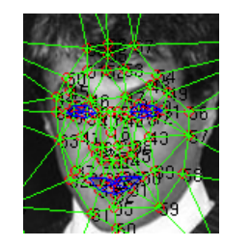
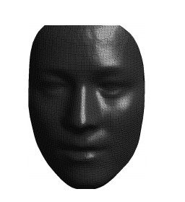
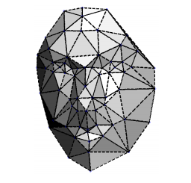
3d alignment

Slide 25
frontalization
Because full perspective projections are not modeled, the fitted camera is only an approximation of the individual’s actual face. To reduce errors, DeepFace aims to warp the 2D images with smaller distortions.

Slide 26
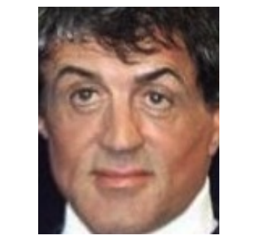
frontalization

Slide 27
Music recommendation
5 Categories of Music
Angry
Happy
Sad
Neutral
Fear

Slide 28
Music recommendation
We recommend music to the users using tkinter. Tkinter is the standard GUI library for Python. Python when combined with tkinter provides a fast and easy way to create GUI applications. We first create an object for tkinter. Then, we define the size of the GUI window. We then store the necessary images in different objects by specifying their paths for later use. We create a class called 'player' in which we define 5 methods. First method is create frames() which creates 3 frames of different sizes as needed. Another function tract_widgets() is to display an image and for song tracking which displays the song name of the song that is currently being played.
Another function retrieve_songs() is to fetch the songs from the system according to the emotion detected and to display them on the frame right side.
Another function control_widgets() is to control the music player which can be play the music, pause the song, go to previous song, go to next song, increase or decrease volume. This is how we created a music player using tkinter.

Slide 29
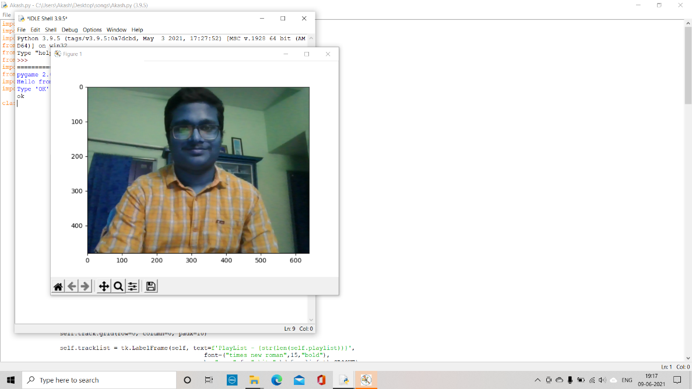
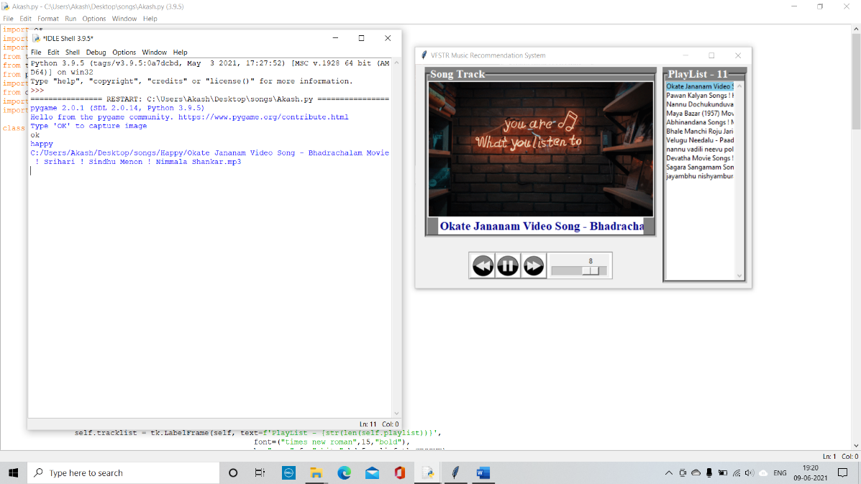
Experimental results
Capturing a Happy Face
Result for a Happy Face

Slide 30
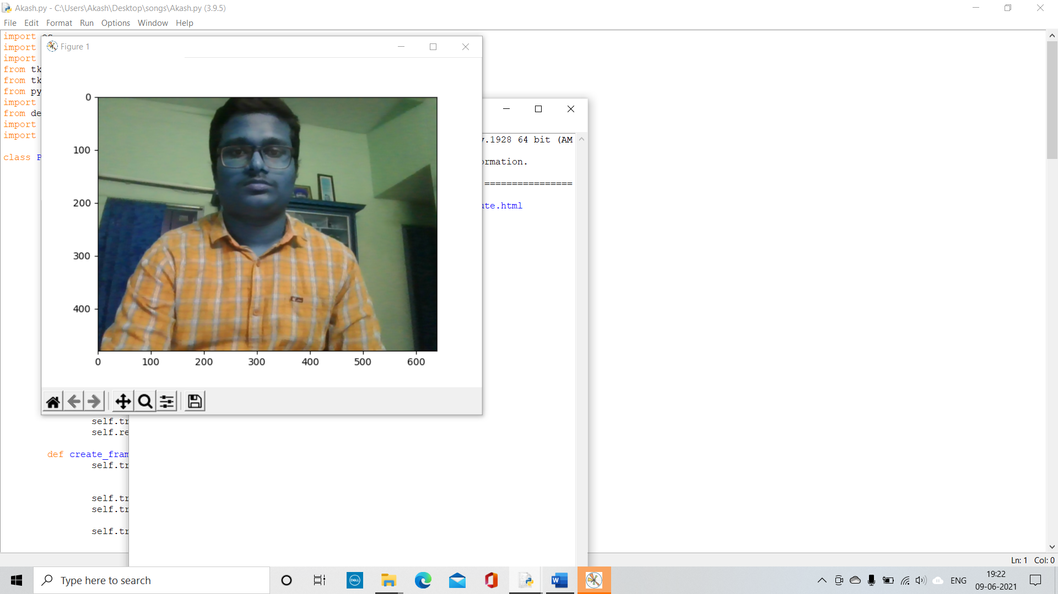
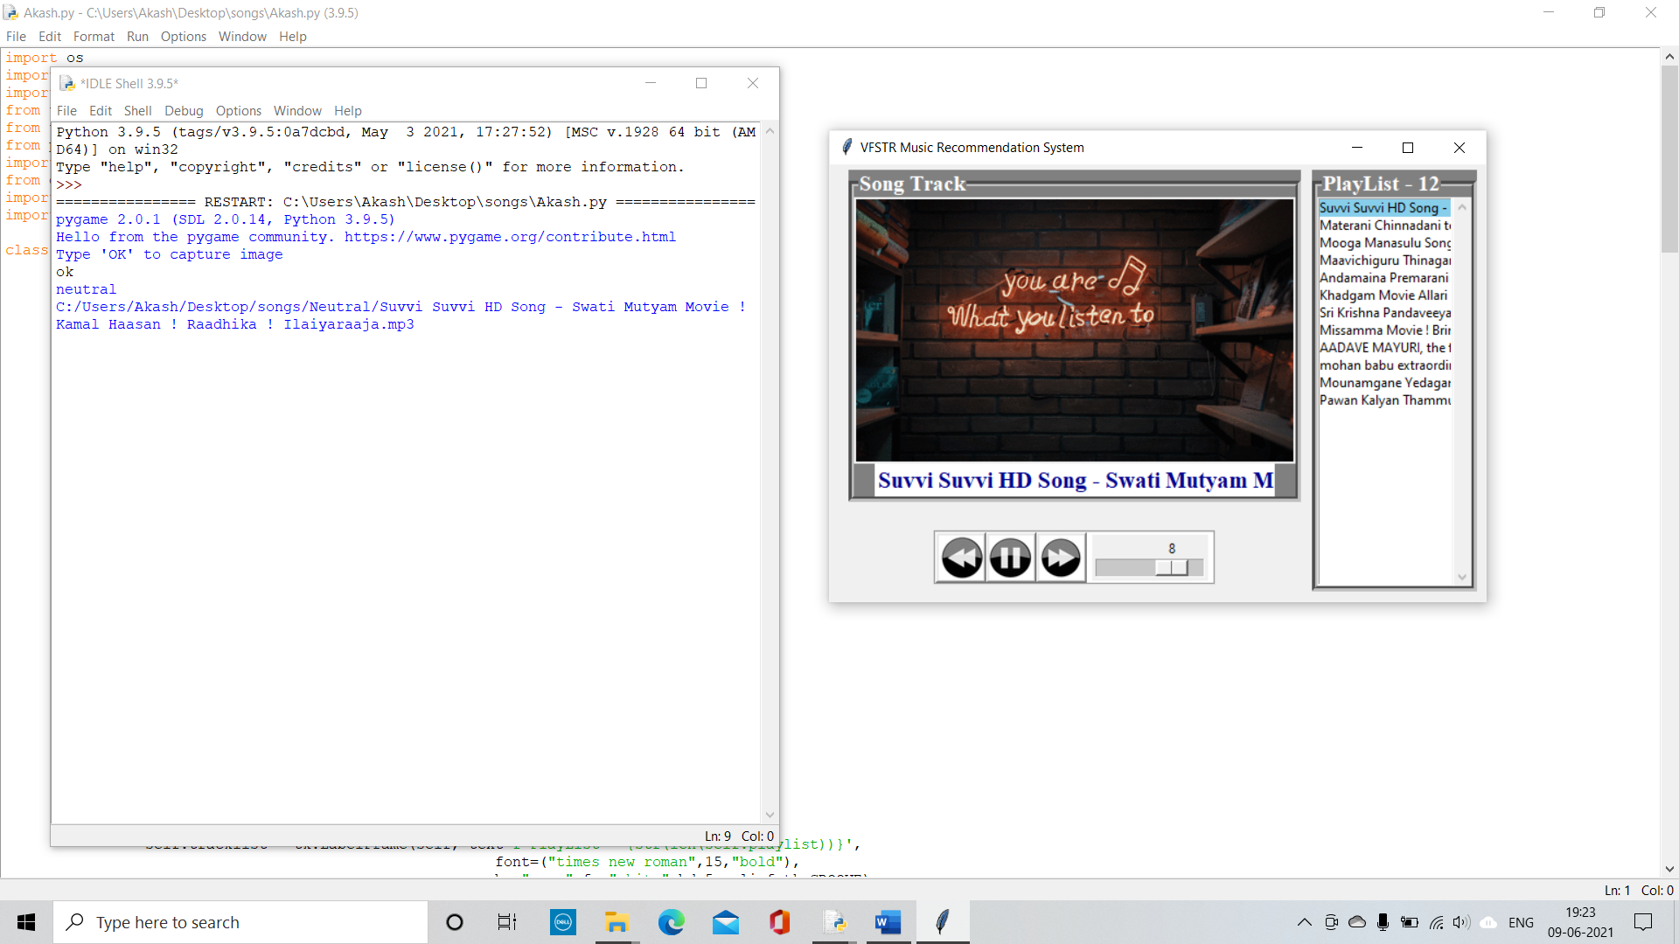
Experimental results
Capturing a Neutral Face
Result for a Neutral Face

Slide 31
CONCLUSION
We would like to do much accurate model in the future and also a modem which detects all the basic 7 emotions which are happy, sad, anger, neutral, fear, disgust, surprise accurately. In the future we want to develop an android app for emotion-based music recommendation system which can be installed in our Android phones easily. We also plan to develop some special features where quotation of some great personalities will be recommended based on the user emotions if the user is detected as sad a song was suggested according to that song a quote will be displayed so that the user can be motivated. People tend to listen lyrics a lot at the same time if quotation were showed they tend to feel motivated or feel active and where they can share it in social media this help at least few people to motivate. And other feature is that if user uses the application most then some points will be added and these points can be used to purchase singer albums. One more thing we want to include is we wish to recommend songs of different languages like Hindi, English, Tamil etc.

Slide 32
Thank you
Batch – 207

